Slide 1





SOFTWARE TOOLS FOR SIMULATION AND OPTIMIZATION
Simulation Study of the Coffee Shop "Cookie-Dream"
Faustino Vazquez Gabino| 203961 Alessandro Sapia | 290742 Elshan Dashtiyev | 297547

Slide 2









System
Process "Production"
Process "Transport"
Process "Coffee Shop"

Slide 3

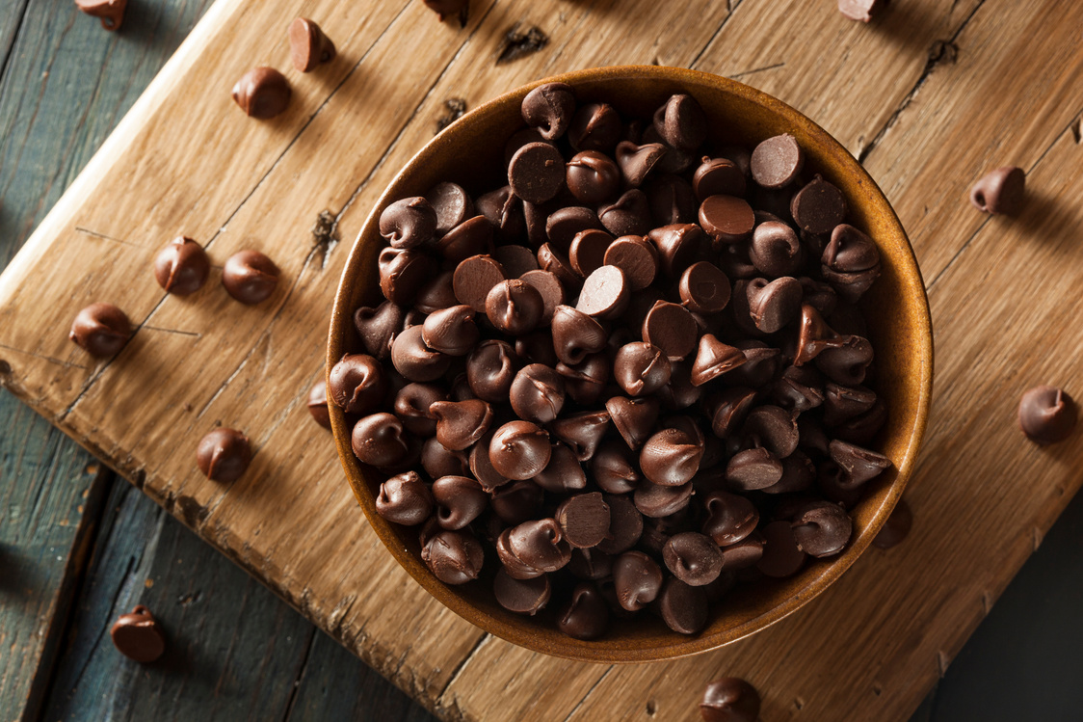
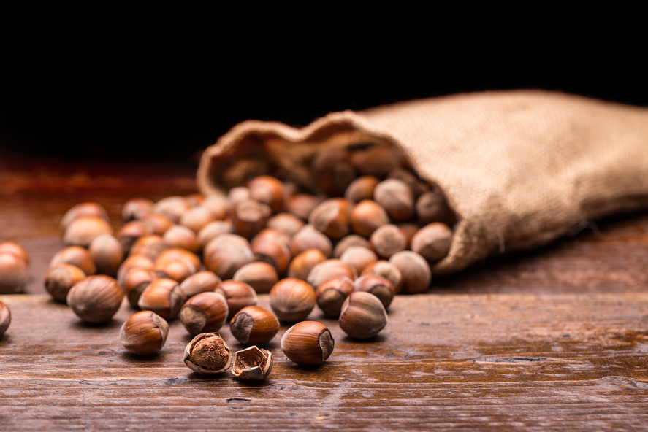
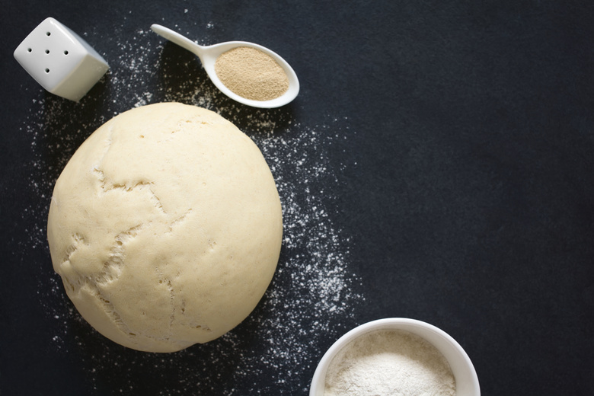
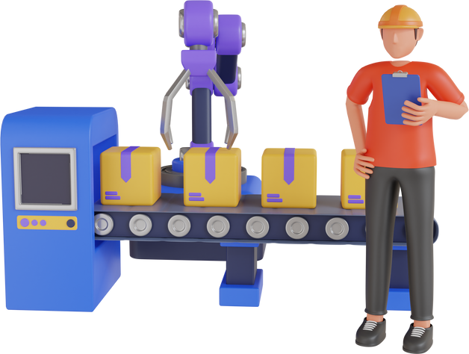

Production
Chocolate
Dough
Hazelnuts
Exp(λ) λ = 2
Exp(λ) λ = 5
Exp(λ) λ = 3
Needs:
1 dough
3 Hazelnuts
Needs:
1 dough
2 chocolate
Machine C
Machine H
U(a,b) a,b =5,35
U(a,b) a,b =5,35

Slide 4
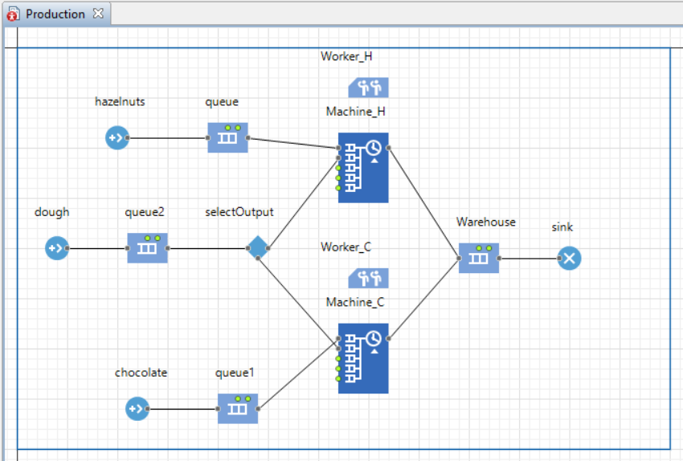


Production Simulation

Slide 5


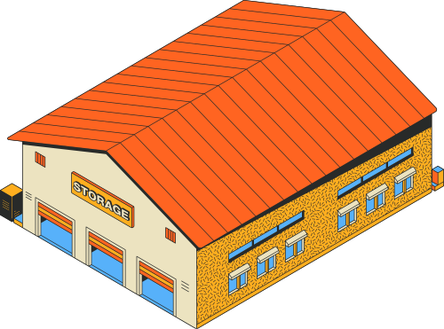



Transport
Warehouse
Coffee Shop
Outward journey
Return journey
Triang (a, b, c) a, b, c = 5,20,10
Triang (a, b, c) a, b, c = 5,20,10

Slide 6
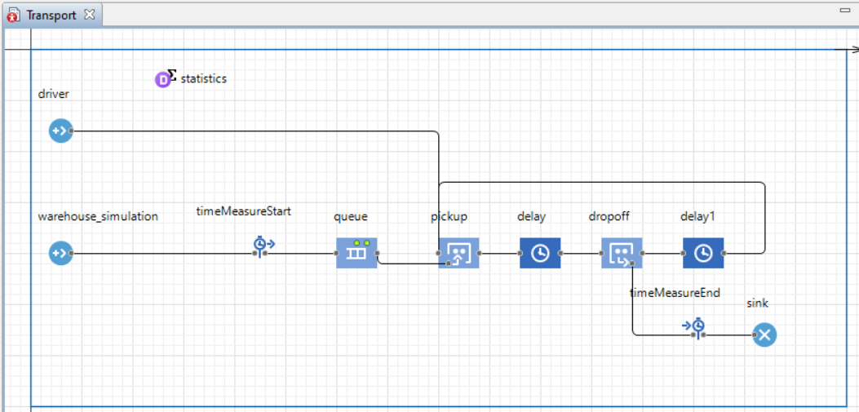

Transport Simulation

Slide 7









Coffee Shop
Prices:
Chocolate Cookie: €5
Hazelnut Cookie: €5
Coffee: €5
Espresso: €3
Customer
Customer Service
Shelf
Dining Area
Arrival : 5 per min
Preferences:
Chocolate: 40% Hazelnut: 60%
Coffee: 70% Espresso: 30%
Matching area
Triang (a, b, c) a, b, c = 5,15,20
Clean Time: Gamma (𝛼,B) 𝛼,B = 5,1
N(𝜇,σ2) 𝜇,σ2 =2,17
After 10 min goes
After 5 min goes
30% Queue up again

Slide 8
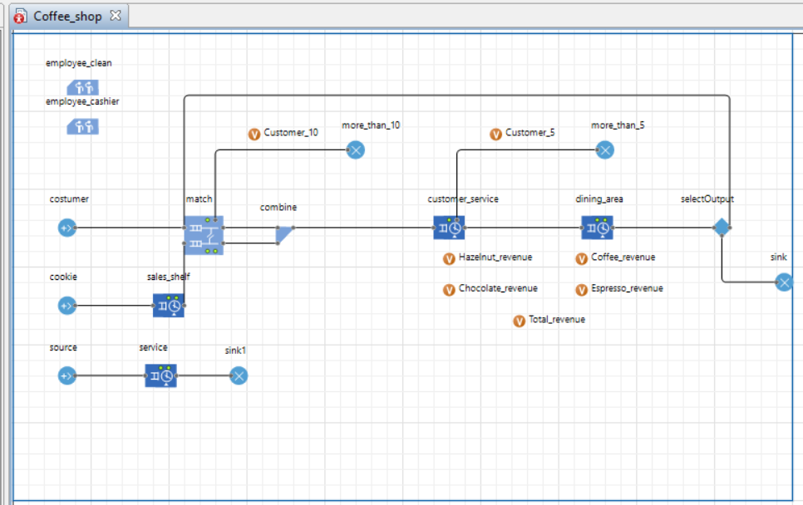
Coffee Shop Simulation

Slide 9
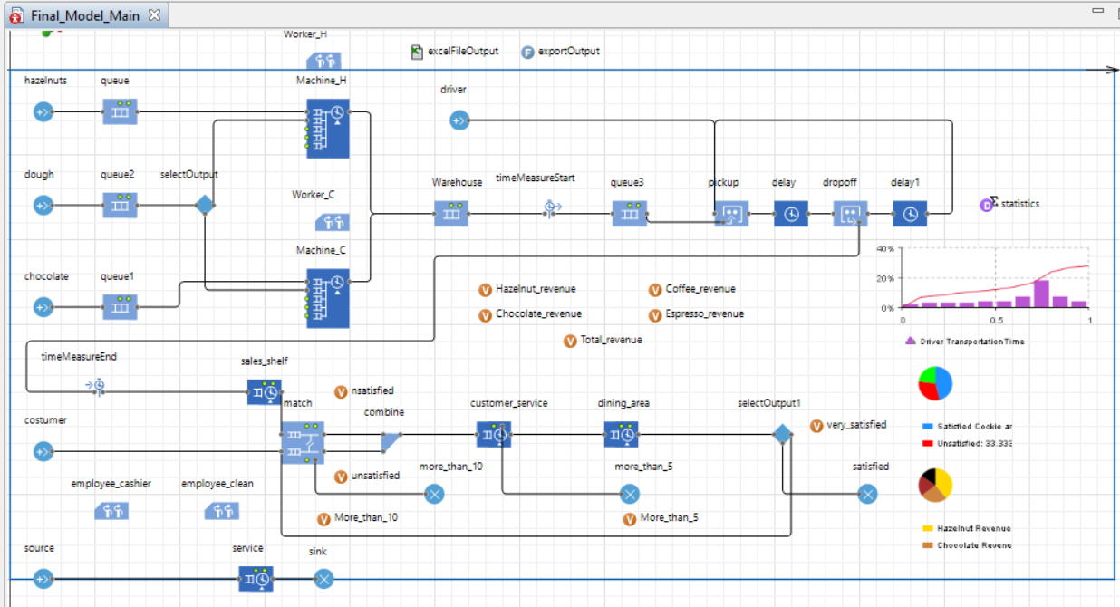
Original Simulation Together

Slide 10
Results

Slide 11


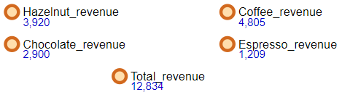
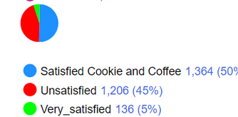
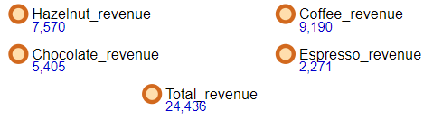
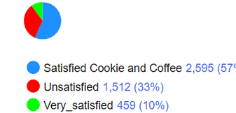
Metrics
Revenue
Customer Satisfaction
Original
1 employees
Original
2 employees

Slide 12

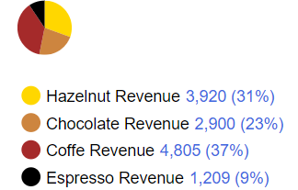


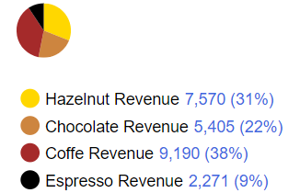
PROBLEMS AND POSSIBLE IMPROVEMENTS
Customer Insatisfaction
Coffee Revenue
Original
1 employee
Original
1 employee
Original
2 employees
Original
2 employees

Slide 13





Coffee Shop Improved
Prices:
Prices:
Coffee: €5
Espresso: €3
Chocolate Cookie: €5
Hazelnut Cookie: €5
Customer
Checkout
Dining Area
Coffee
Shelf
Arrival : (First customer
after 1 hour)
5 per min
Preferences:
Chocolate: 40% Hazelnut: 60%
Coffee: 70% Espresso: 30%
Matching area
N(𝜇,σ2) 𝜇,σ2 =2,17
Triang (a, b, c) a, b, c = 5,15,20
Clean Time: Gamma (𝛼,B) 𝛼,B = 5,1
After 10 min goes
to checkout

Slide 14
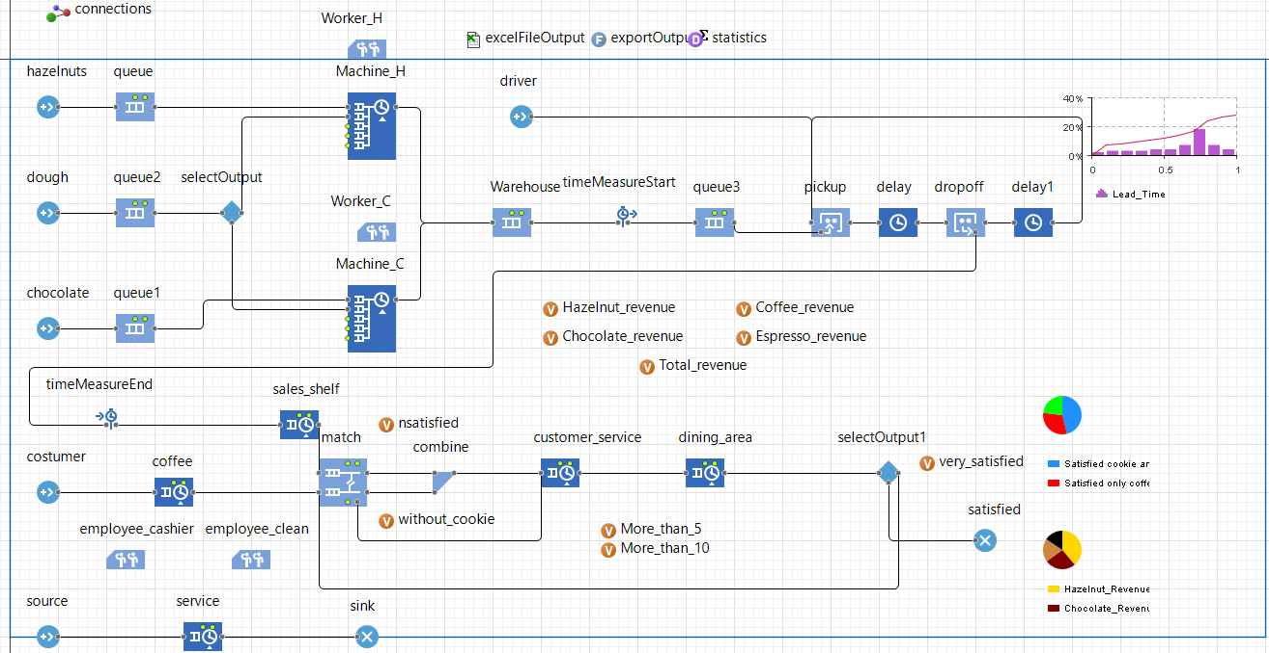
Modified Simulation

Slide 15
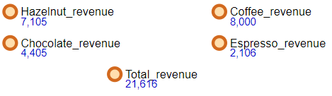
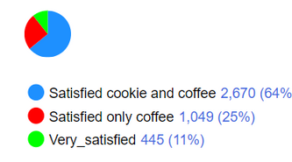
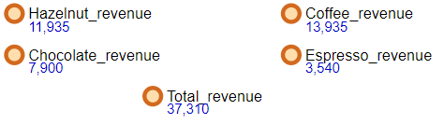
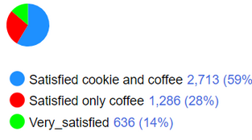
Results
Revenue
Customer Satisfaction
Modified
1 employees
Difference :
+8,782
0 Unsatisfied + 1,049 Satisfied with coffee
+ 309
Difference : +8,782
Modified
2 employees
Difference :
+118
0 Unsatisfied + 1,286 Satisfied with coffee
+178
Difference : +12,874

Slide 16


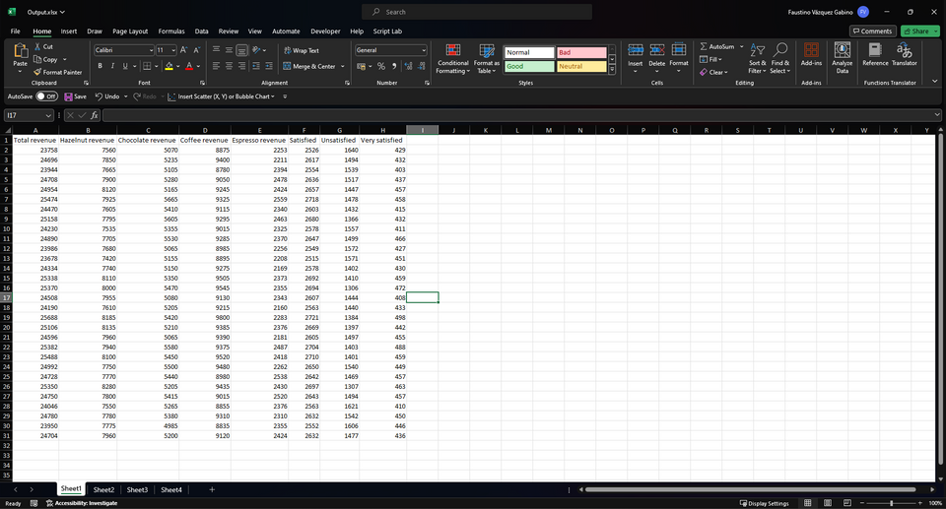
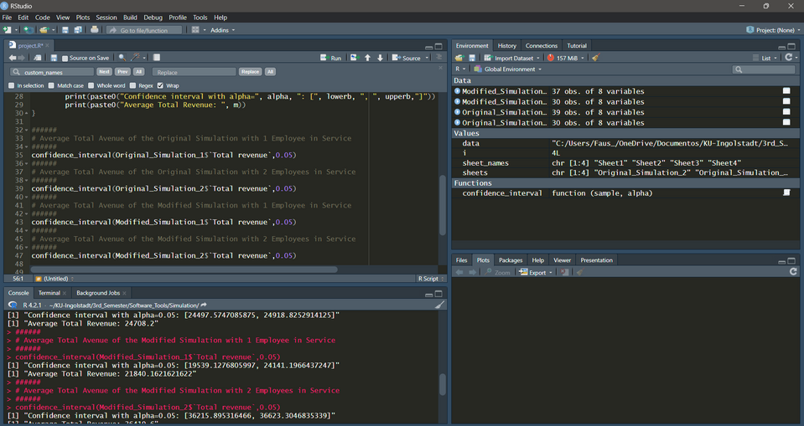

Analysis of Results
Data from 30 replications

Slide 17
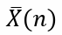
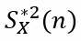
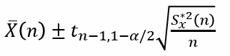

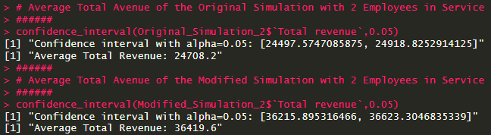



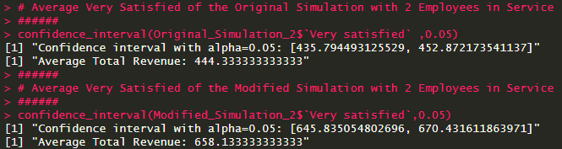
Analysis of Results
Sample mean
Corrected sample variance
Confidence interval for mean
replications n = 30 alpha = 0.05
Revenue
Customer satisfaction

Slide 18
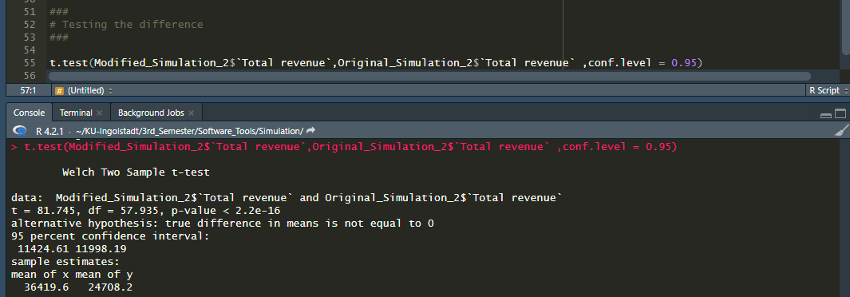
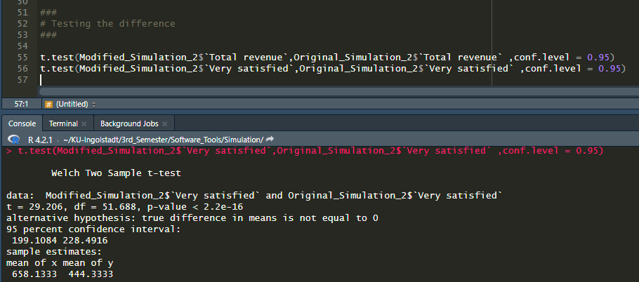
T-Test
Revenue
Customer satisfaction

Slide 19

Conclusion
Critical discussion of assumptions
Positive results
Increase Revenue
Increase customer satisfaction
Confidence interval for mean
T-test

Slide 20

Thank you!

